Slide 1

World’s largest data science knowledge portal

Slide 2

Location: Bangalore , India
Saturday, Jun 03, 2017
Notes:
This is the elevator pitch - audience should clearly grasp what you are providing in one sentence e.g. “Standardised & Centralised Telecom Billing platform for 110 countries at 1/5th the cost and 1/2 the cycle time for billing”. State powerful illustrative example of of platform adoption

Slide 3
Model building – life cycle
We can broadly divide the model building life cycle in six stages:
Problem Definition
Data Extraction / Collection
Data Exploration and Transformation
Predictive Modeling
Hypothesis Generation
Model Deployment/ Implementation

Slide 4
Hands on Exercise: Problem Identification
Help a company “HacKart” by creating an efficient email strategy. Predicting the outcome of an e-mail (No action, Email opened but no action, Email opened and clicked on product/link)

Slide 5
Hands on Exercise: Hypothesis Generation
Yes, we must do hypothesis generation exercise before looking at the data
Notes:
Always think through the problem and list down all the variables

Slide 6
Hands on Exercise: Hypothesis Generation
List down all the variables which might influence the email action

Slide 7
Hands on Exercise: Hypothesis Generation
Length of email
….
Time for an exercise: Share your list of variable those can impact target variable
Notes:
Ask them to share their variable and why they are thinking that it is important

Slide 8
Hands on Exercise: Data Collection/ Extraction
In practical scenarios, we collect data from different sources. Specially in this case, we have collected data from different sources like:
Government / Private Agencies
School/ Universities
Bank
Data Source 2 (School/ Universities)
Data Source 1 (Agencies)
Data Source 3 (Bank)
Data Extraction & Collection
Thankfully, in this case we have all the data collected. So, no need to go through this process again !
Notes:
Bradly data collection process look like this

Slide 9
Hands on Exercise: Data Collection/ Extraction
Few action items for you !!!
Download data set (Train, Test, Sample Submission)
Get set ready for data exploration journey

Slide 10
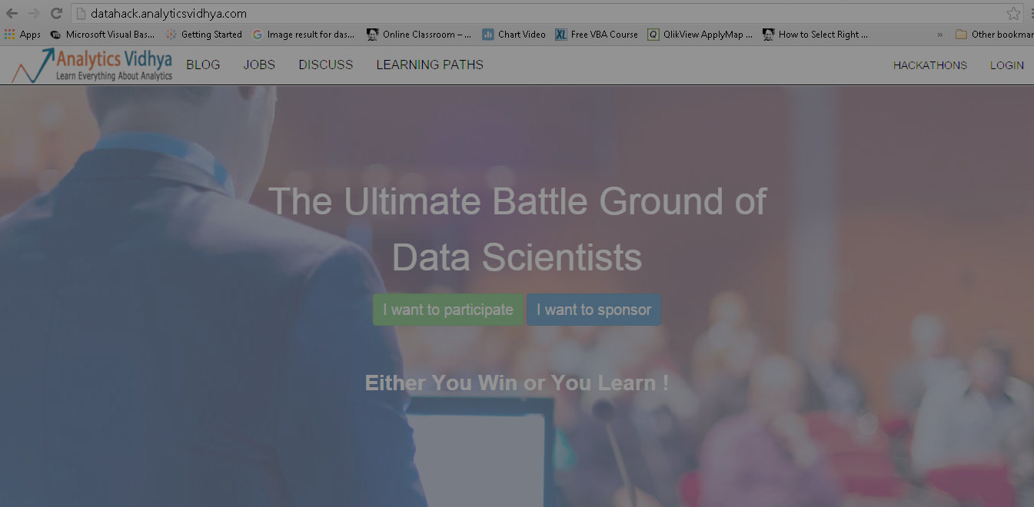
Sign-Up/Login on datahack.analyticsvidhya.com
Register for contest “AV LearnUp Bengaluru: Marketing & Social Media Analytics”

Slide 11
Hands on Exercise: Data Collection/ Extraction
Here, we have train and test data set
Dataset
Train
Test
Total 12 variables
1 ID, 10 independent and 1 dependent variable
Dependent variable known (Email_Status)
Total 68,353 observations
Total 11 variables
1 ID and 10 independent variables
Dependent Variable unknown (Email_Status)
Total 45,978 observation

Slide 12
Hands on Exercise: Data Collection/ Extraction
Here, we have train and test data set
Dataset
Train
Test
Sample Submission is a format to submit the test data set prediction to solution checker (It has only two columns “Email_ID” and “Email_Status”)
Total 19 variables
1 ID, 17 independent and 1 dependent variable
Dependent variable known (Outcome)
Total 28,937 observations
Total 18 variables
1 ID and 17 independent variables
Dependent Variable unknown (Outcome)
Total 12,251 observation

Slide 13
Look at the Available Features
Variable_Name | Definition
Email_ID | Unique Email ID
Email_Type | Type of E-mail (1 / 2)
Subject_Hotness_Score | Hotness score of Subject given by Email Marketing Tools (On the scale of 0 to 5, higher is better)
Email_Source_Type | Source of Email (1 / 2)
Customer_Location | Location of Customer ( A/ B/ C/ D/ E/ F/ G)
Email_Campaign_Type | Email Campaign Type (1/ 2/ 3)
Total_Past_Communications | Total past communication in three months
Time_Email_sent_Category | Email sent Time Category (1/ 2/ 3)
Word_Count | Total words in the mail
Total_Links | Total available links in the mail
Total_Images | Total images in the mail
Email_Status | Dependent Variable (0: Not Responded, 1:Open Email, 2:Click on Link)

Slide 14
Data Exploration & Feature Engineering
Import data set
Variable identification
Univariate, Bivariate and Multivariate analysis
Identify and Treat missing and outlier values
Create new variables or transform existing variables

Slide 15
Predict: Based on a some rule(s)
Identify some rule(s) to predict a Email Outcome

Slide 16
Predict: Model based solution
Build model to predict a Email Outcome

Slide 17


Thank You
Contact:
Analytics Vidhya
info@analyticsvidhya.com

